Slide 1
KAMALA HARRIS
Stories of excellence
Student health and human services
Office of human relations, diversity and equity
July 2022
Notes:
Please feel free to encourage student participation whichever way you are most comfortable: in the Zoom chat, on a previously shared Jamboard, in break out groups, or all together in a grid view. There will be a lot of opportunities for participation throughout this presentation.

Slide 2
Welcome!
Thanks for being here today!
We are going to start with a check in – everyone please go ahead and share one thing you LOVE.
Notes:
Invite the students to share something – anything – they love. Could be an object, a person, a musician, an author. May be helpful if you offer to share first.

Slide 3
Objectives
Learn about the Vice-Presidents early life
Explore potential impact of Kamala Harris' early life on her ambitious future
Reflect on what it means to be the "FIRST" to accomplish something
Notes:
Read the objectives aloud for the student.

Slide 4
Who is Kamala Harris?
Notes:
Prior to playing the video, ask the students for volunteers to share what they already know about Kamala Harris.
https://www.youtube.com/watch?v=GNaOg3koQS0
4:19

Slide 5
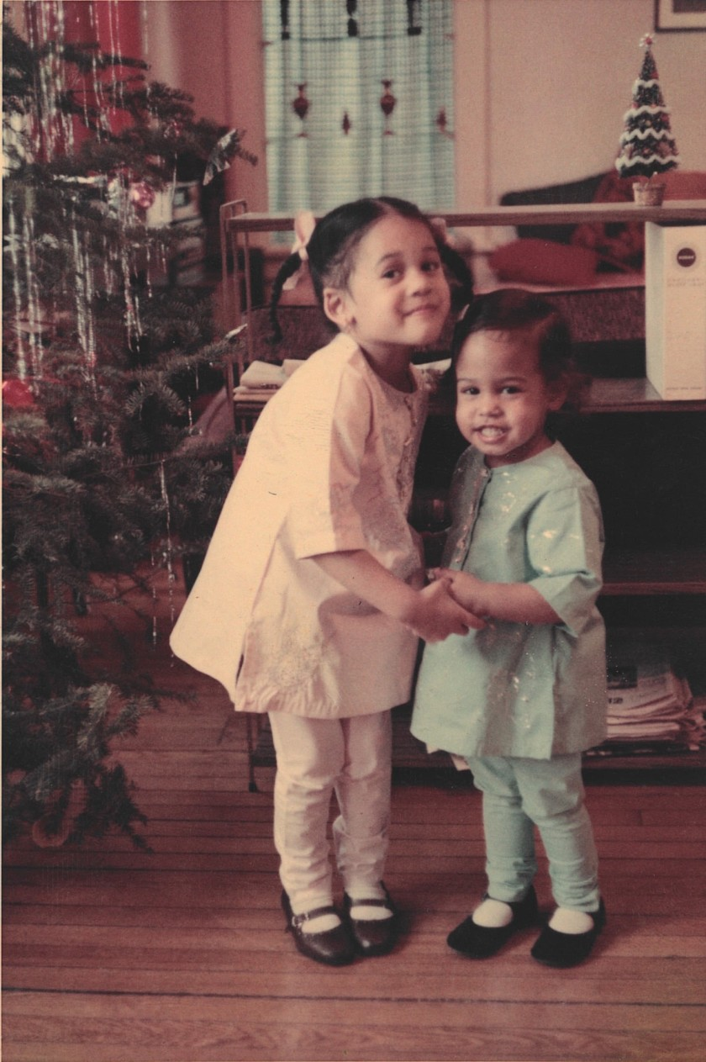
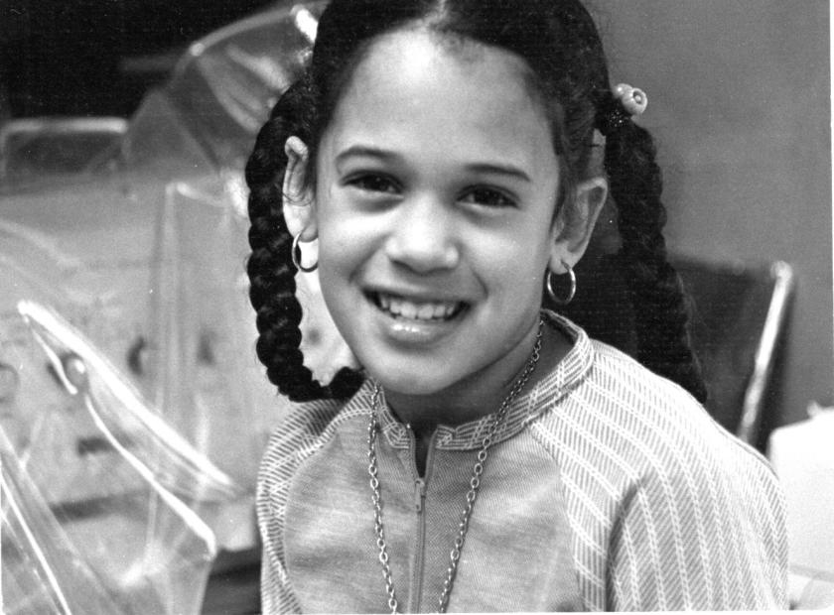
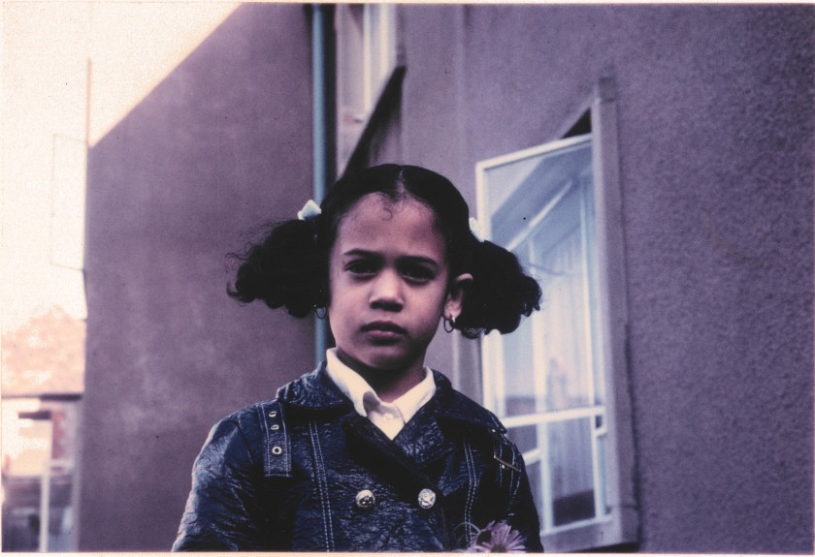
First generation
Kamala Harris was born in 1964 to immigrant parents. Her mother is from India and her father is from Jamaica.
Kamala grew up in Oakland. CA.
She said she had a “stroller-eye view” of the civil rights movement. Her parents often took her and her sister to protests and rallies.
At the age of 12, Kamala moved to Quebec (Canada) where she attended a French-speaking school.
Notes:
Read the slide for the students. Point out the pictures top left Kamala and her sister, Maya as children. Top right, Kamala's childhood home was an ordinary apartment in Oakland. Bottom pictures of Kamala as a child.

Slide 6
reflection
What does it mean to be “first generation”?
What do you think it was like for Kamala to attend middle school and not speak the same language as her classmates and teachers?
Notes:
Invite the students to reflect and share on what they think it means to be "First generation". Explain to the students that being "first generation" is generally agreed to mean the child of an immigrant.
Invite the students to reflect on the second question as well.

Slide 7
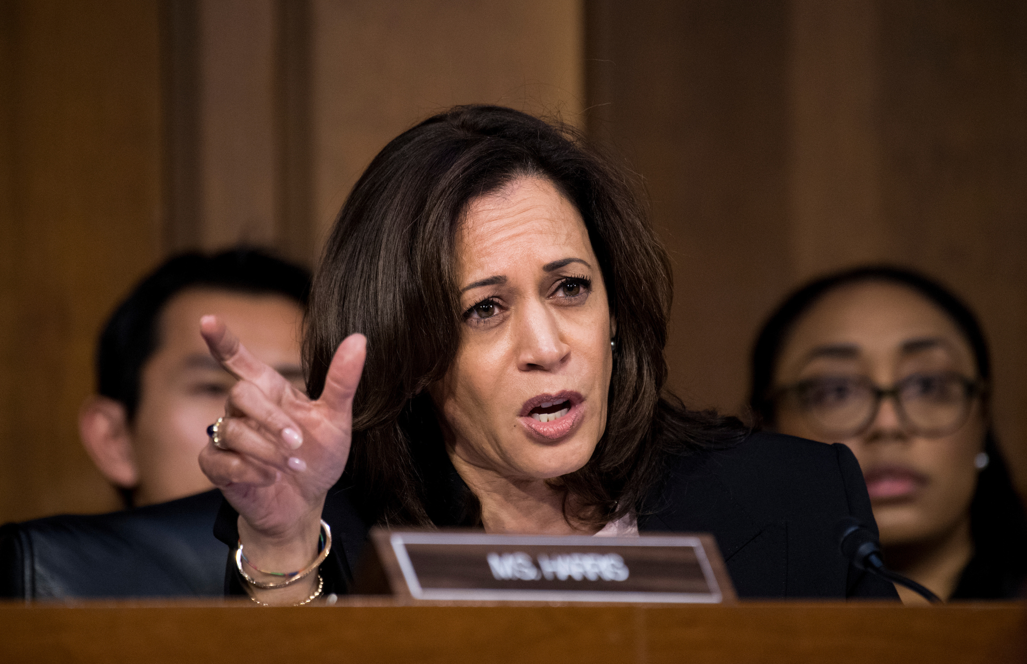
A Long List of FIrsts
Kamala Harris was the first:
Jamaican-American , woman, and Asian-American to become the attorney general of California. (2011)
South-Asian attorney general in the entire United States (2011)
Indian-American (and second African-American woman) to serve as a United States Senator (2017)
African-American woman to represent California in the United States Senate (2017)
Woman elected Vice President of the United States of America (2020)
African-American elected Vice President of the United States of America (2020)
Person of Asian descent elected Vice President of the United States of America (2020)
Notes:
Take a minute and really spend time slowly going through these various FIRST. Point out to the students that these things were NOT that long ago. Make mention that it wasn’t until 2011 that CA had its FIRST WOMAN Attorney General? In 2017 (3 years ago) Kamala was still only the SECOND Black woman to be a US Senator?

Slide 8
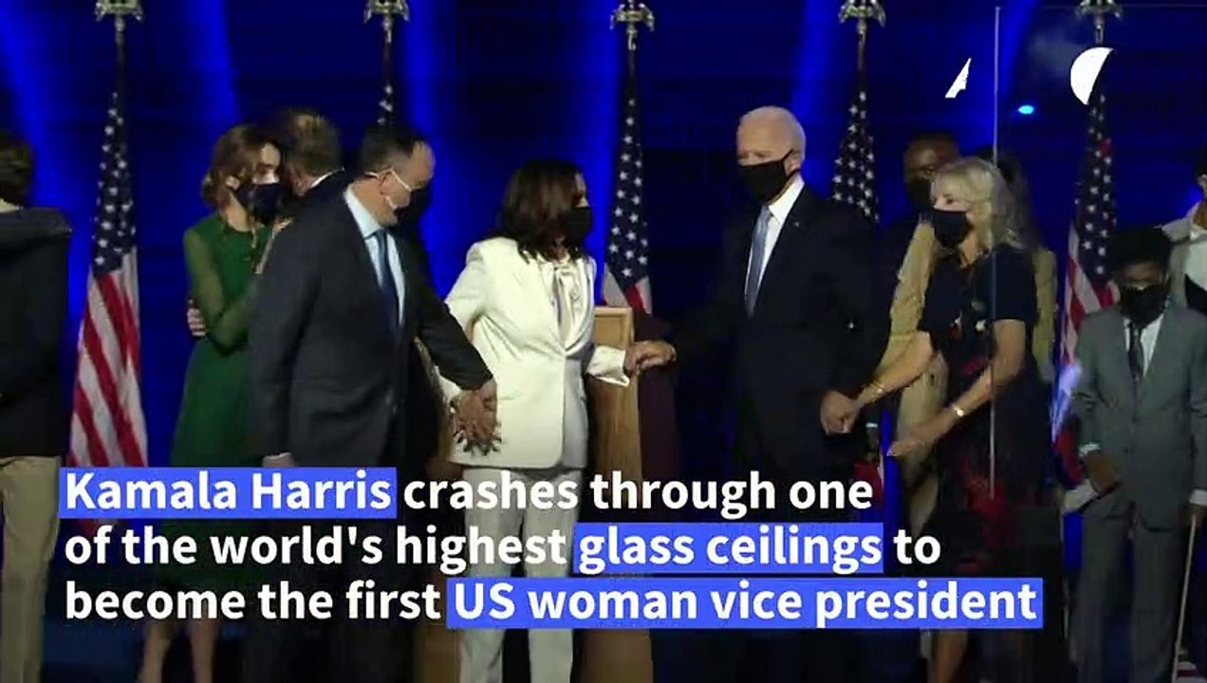
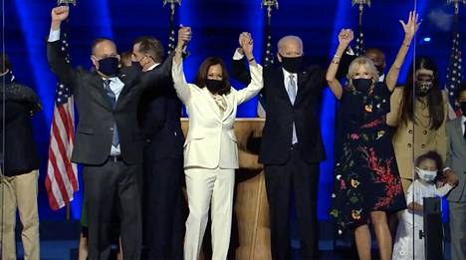
FIRST WOMAN VICE PRESIDENT

Slide 9
reflection
If you could be the ‘first’ of something, what would it be?
Notes:
Encourage the students to think about their wishes and dreams for their future – if they could be the “first” of something, what would it be? i.e. this write wanted to be the FIRST woman athletic trainer for a Major League Baseball Team when she was in high school. Invite the students to DREAM BIG and let Kamala’s story remind them that their potential has no limits!

Slide 10
Checkout
If you could live anywhere, where would you want to live?
Notes:
Provide this check out reflection question and encourage the students to imagine the possibilites of where their lives can take them!

Slide 11
Human relations, diversity & Equity

Slide 12
Teacher feedback
Notes:
Teacher, please complete a brief feedback form by scanning the QR code or using the link below.
https://forms.office.com/r/i9UqyyxzTT

